Slide 1



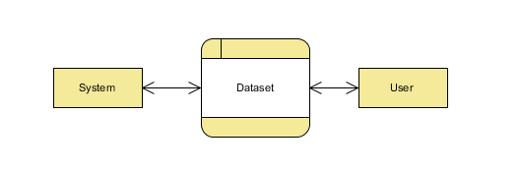
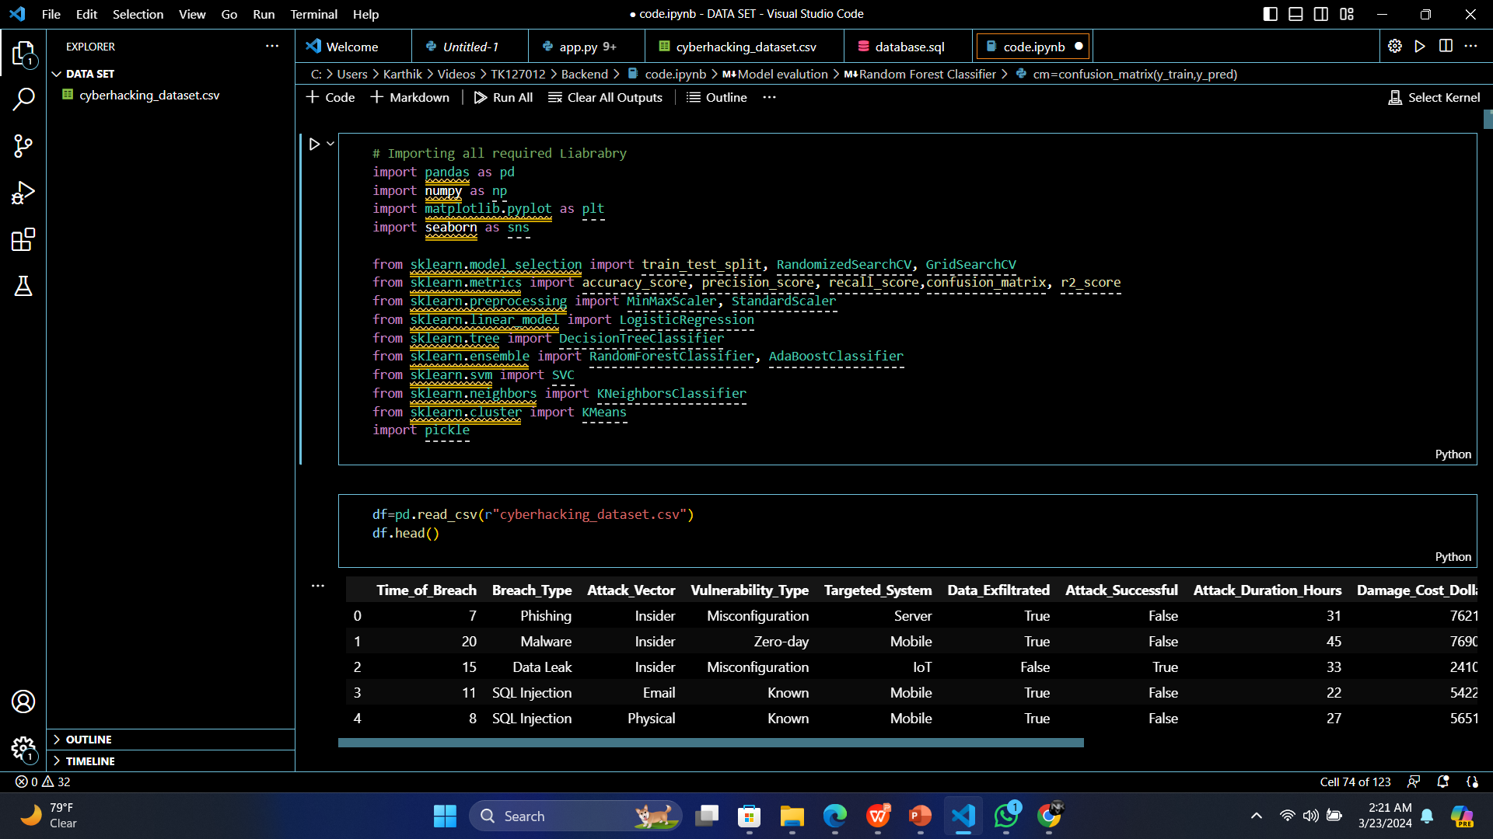
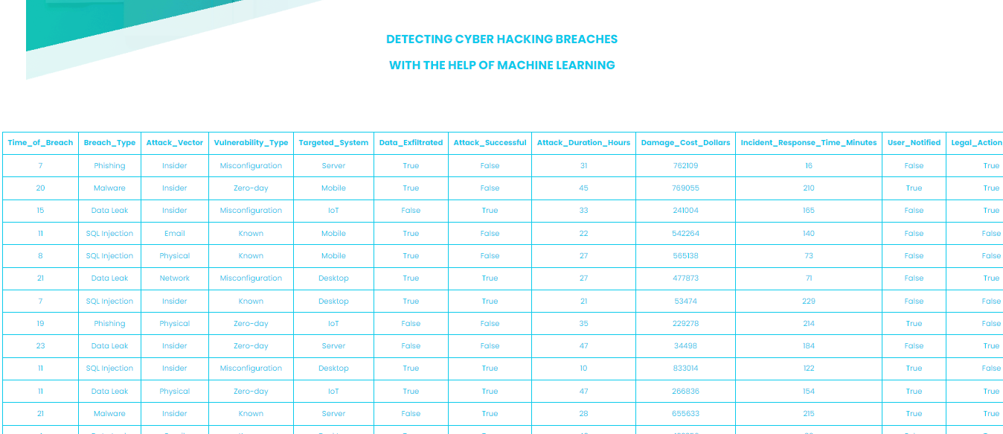

CYBER HACKING BREACHES PREDICTION USING MACHINE LEARNING
Department of Computer Science and Engineering Batch: (2020-2024)
School of Computing
1156CS701-MAJOR PROJECT
INTERNSHIP THROUGH DIND
ENCORA PVT.LTD
WINTER SEMESTER 2023-2024
ABSTRACT
INTRODUCTION
RESULTS
STANDARDS AND POLICIES
Cyber-physical systems (cps) have made significant progress in many dynamic applications due to the integration between physical processes, computational resources, and communication capabilities. However, cyber-attacks are a major threat to these systems. Unlike faults that occurs by accidents cyber-physical systems, cyber-attacks occur intelligently and stealthy. Some of these attacks which are called deception attacks, inject false data from sensors or controllers, and also by compromising with some cyber components, corrupt data, or enter misinformation into the system. If the system is unaware of the existence of these attacks, it won’t be able to detect them, and performance may be disrupted or disabled altogether. Therefore, it is necessary to adapt algorithms to identify these types of attacks in these systems. It should be noted that the data generated in these systems is produced in very large number, with so much variety, and high speed, so it is important to use machine learning algorithms to facilitate the analysis and evaluation of data and to identify hidden patterns.
Random forest classifier
confusion_matrix = [[4160 321]
[ 445 4074]]
accuracy = 0.9148888888888889
precision_score = 0.926962457337884
recall_score = 0.9015268864793096
General Data Protection Regulation (GDPR):
GDPR establishes rules for data protection and privacy for individuals within the European Union (EU) and the European Economic Area (EEA). It imposes obligations on organizations regarding the collection, processing, and protection of personal data.
NIST Cybersecurity Framework:
Developed by the National Institute of Standards and Technology (NIST), the NIST Cybersecurity Framework provides a set of guidelines, standards, and best practices for improving cybersecurity risk management.
Ethical Guidelines for AI and Machine Learning:
Adhere to ethical guidelines and principles for the development and deployment of artificial intelligence (AI) and machine learning systems. This includes considerations such as fairness, transparency, accountability, and the avoidance of bias in algorithmic decision-making.
The advent of the digital age has ushered in unprecedented opportunities for connectivity and innovation. However, it has also given rise to a growing menace – cyber hacking breaches. In recent years, cyberattacks have become increasingly sophisticated and devastating, posing a significant threat to individuals, businesses, and even nations.This project aims to comprehensively investigate and analyze cyber hacking breaches that occurred in the past year. We will delve into the methods, motivations, and impacts of these breaches to gain a deeper understanding of the evolving landscape of cyber threats. By examining a range of high-profile cases, we intend to identify common vulnerabilities and attack vectors.
Our objectives include mapping the tactics employed by hackers, assessing the effectiveness of security measures, and evaluating the financial and reputational costs incurred by victims. Additionally, we will explore the ethical, legal, and regulatory aspects surrounding cyberattacks and data breaches.
Table 1. Label in 20pt Calibri.
Figure 1. Label in 20pt Calibri.
Figure 2. Label in 20pt Calibri.
METHODOLOGIES
CONCLUSIONS
Take the Dataset: The system accepts and processes the dataset provided by the user. This dataset forms the foundation for building the predictive model.
Preprocessing: Before training a predictive model, the system preprocesses the dataset. This includes handling missing data, data cleaning, and feature extraction. Preprocessing ensures that the data is in a suitable format for modeling.
Training: The system uses machine learning techniques and Python modules to train a model based on the preprocessed dataset. The model learns patterns and relationships within the data, allowing it to make predictions.
Generate Results: Once the model is trained, the system can generate results based on user input values. These results typically indicate whether the input data corresponds to a specific condition, event, or prediction, such as detecting predict the type of Disease.
The conclusion of the proposed approach for cyber hacking breaches prediction lies in its innovative utilization of machine learning algorithms to proactively identify and forecast potential cyber threats. Unlike traditional methods, this framework leverages advanced data analytics to discern subtle patterns and anomalies within vast datasets, enabling early detection of potential hacking breaches.
TEAM MEMBER DETAILS
<Student 1. vtu 15337/Nalluri Karthik>
<Student 2 .vtu 17731/Kota Manish >
<Student 1. Phone no-9353354620>
<Student 2. Phone no-9618012585>
<Student 1. -vtu15337@veltech.edu.in>
<Student 2. -vtu17731@veltech.edu.in>
ACKNOWLEDGEMENT
Project Supervisor Name- DR.P.J.BESLIN PAJILA,ME.,Ph.D.,
Project supervisor Contact No-+918056458326
Project supervisor Mail ID-drbeslinpajilapj@veltech.edu.in
Chart 1. Label in 20pt Calibri.

